Slide 1

David M. Kroenke and David J. Auer Database Processing Fundamentals, Design, and Implementation
Chapter Ten B:
Managing Databases with
Oracle Database 11g Release 2

Slide 2
Chapter Objectives
To install Oracle Database 11g Release 2 and create a database
To use Oracle Database 11g Release 2’s Web-based Database Control Enterprise Manager utility
To use Oracle Database 11g Release 2’s graphical utilities
To create and use Oracle Database 11g Release 2 tablespaces
To understand how Oracle Database 11g Release 2 implements server and database security

Slide 3
Chapter Objectives
To submit both SQL DDL and DML via the SQL Developer
To understand the use of SQL/Persistent Stored Modules (SQL/PSM) in Oracle Database PL/SQL
To understand the purpose and role of user-defined functions and know how to create simple user-defined functions
To understand the purpose and role of stored procedures and learn how to create simple stored procedures

Slide 4
Chapter Objectives
To understand the purpose and role of triggers and learn how to create simple triggers
To understand how Oracle Database 11g Release 2 implements concurrency control
To understand the fundamental features of Oracle Database 11g Release 2 backup and recovery facilities

Slide 5
Introduction
Oracle is the world’s most popular DBMS—it is a powerful and robust DBMS that runs on many different operating systems.
Oracle DBMS engine is available in several versions:

Slide 6
View Ridge Gallery
View Ridge Gallery is a small art gallery that has been in business for 30 years.
It sells contemporary European and North American fine art.
View Ridge Gallery has one owner, three salespeople, and two workers.
View Ridge Gallery owns all of the art that it sells—it holds no items on a consignment basis.

Slide 7
Application Requirements
View Ridge Gallery application requirements
Track customers and their artist interests
Record gallery’s purchases
Record customers’ art purchases
List the artists and works that have appeared in the gallery
Report how fast an artist’s works have sold and at what margin
Show current inventory in a Webpage

Slide 8
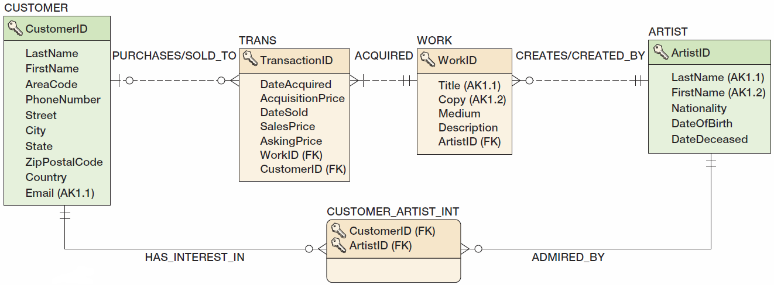
View Ridge Gallery Database Design

Slide 9
The Loopback Adapter
If you are installing Oracle Database 11g Release 2 on a computer that gets an IP number from a DHCP server, you must install a loopback adapter before installing Oracle Database 11g Release 2.
This is probably the case if your are installing a Personal Edition or an Developer License version on your own computer.
Instructions for the Windows OS are in the Installation Guide for Microsoft Windows, Section 2.3.5.

Slide 10
Creating an Oracle Database
Three ways to create an Oracle database:
Via the Oracle Database Configuration Assistant
Via the Oracle-supplied database creation procedures
Via the SQL CREATE DATABASE command
However, what we normally call a database is represented by a tablespace in Oracle.
Oracle creates database instances which can hold many tablespaces.

Slide 11
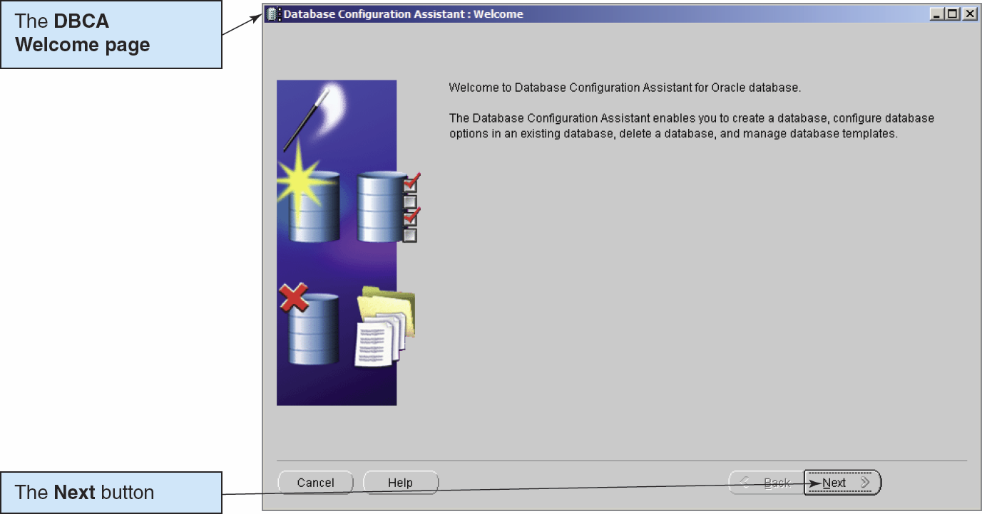
Creating an Oracle Database: The Oracle Database Configuration Assistant

Slide 12
Oracle Database 11g Release 2 Administration
For database administration, use the Web-based Enterprise Manager Database Control utility.
For database development, use the GUI SQL Developer utility.
Old Oracle hands may still prefer the text-based SQL*Plus utility.

Slide 13
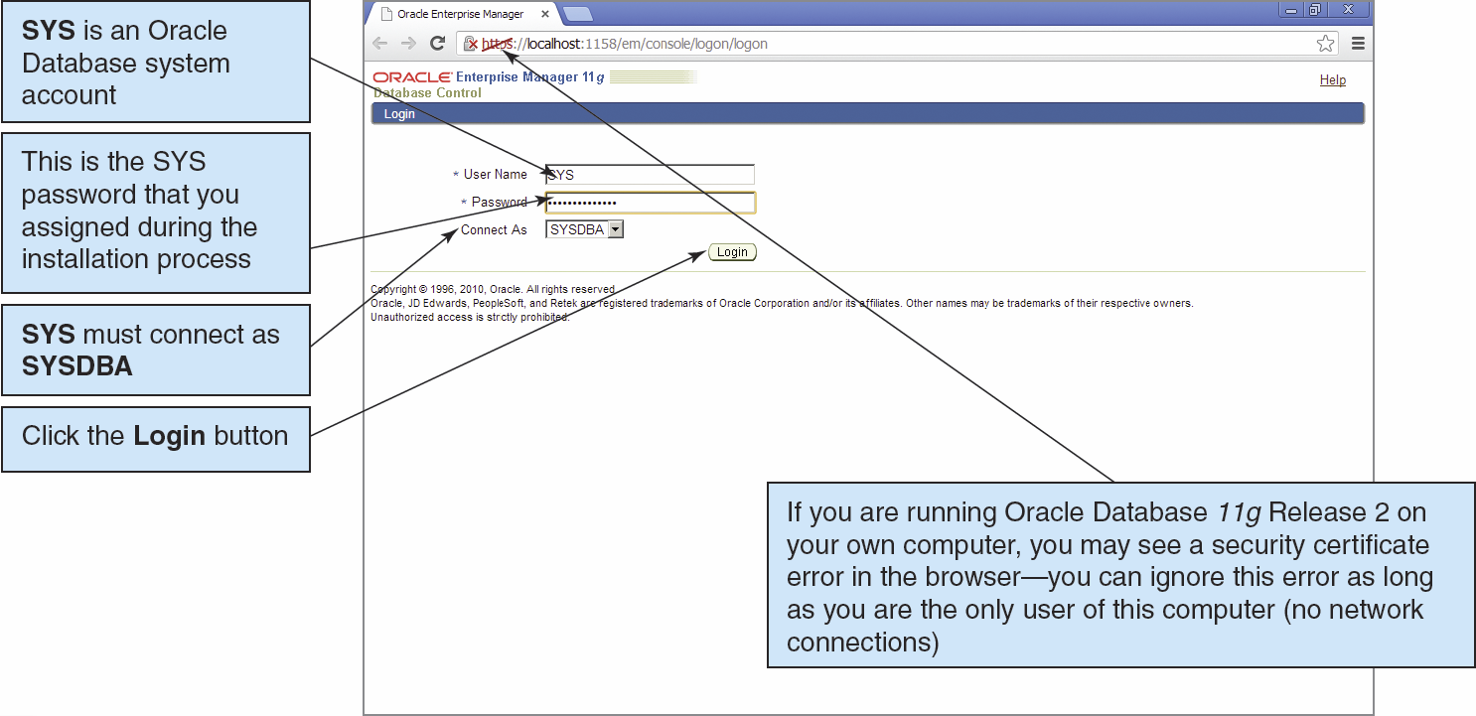
The Enterprise Manager Database Control I

Slide 14
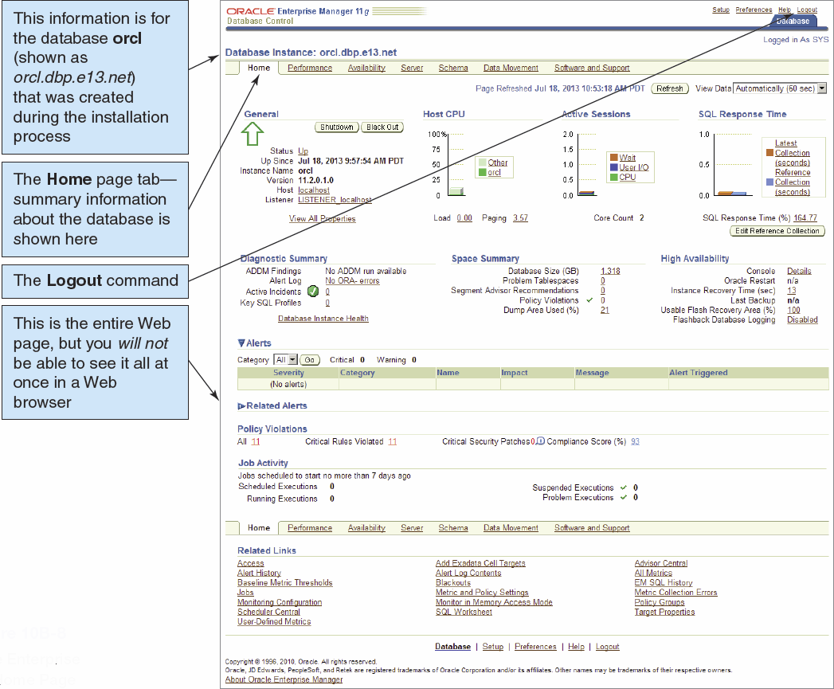
The Enterprise Manager Database Control II

Slide 15
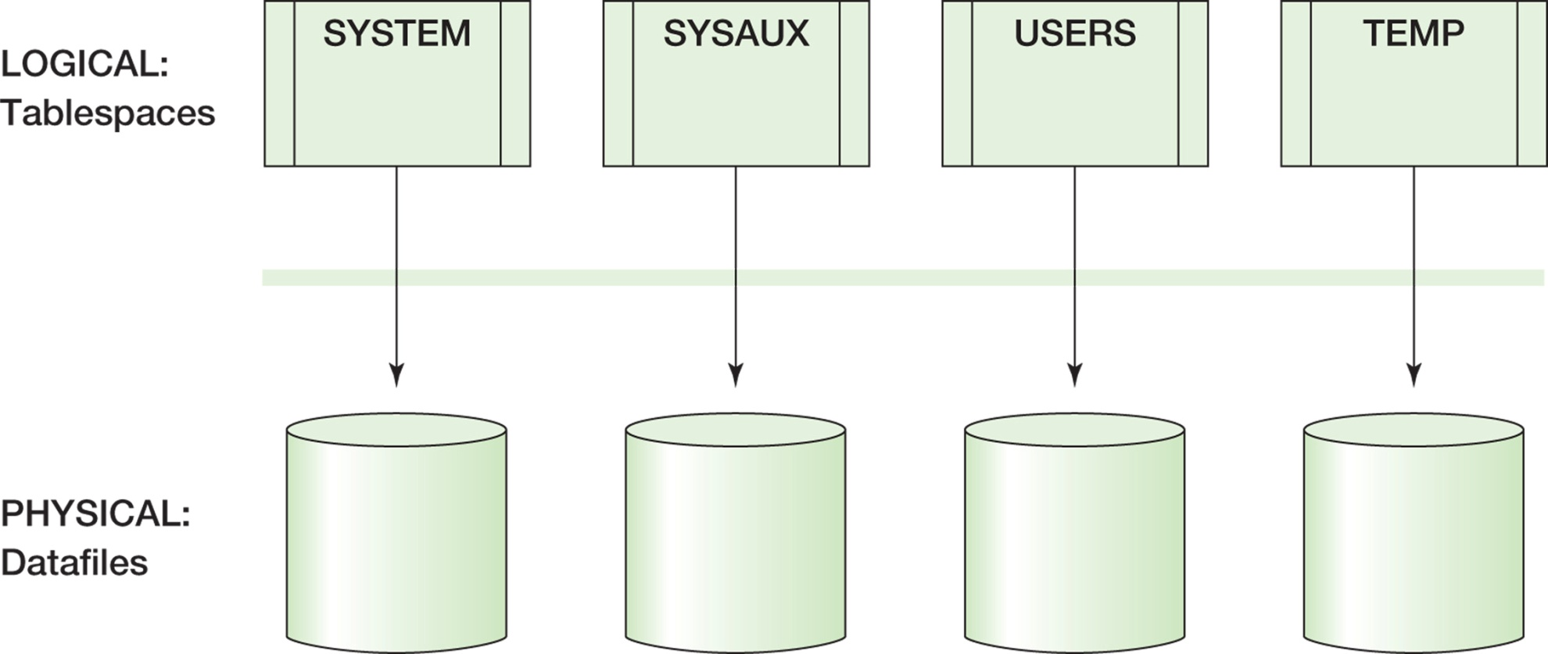
Tablespaces I

Slide 16
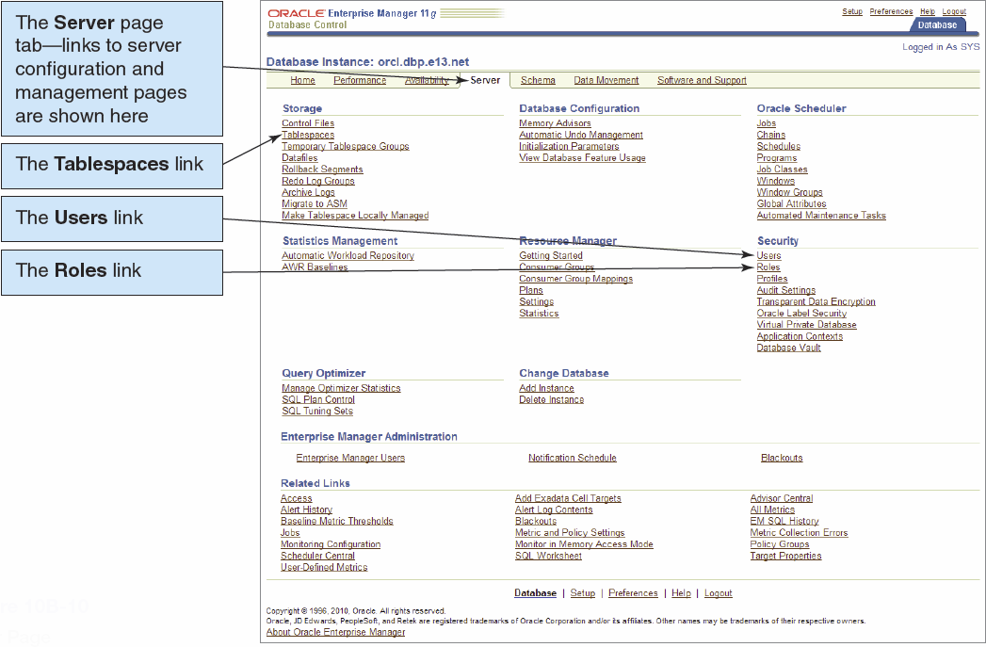
Tablespaces II

Slide 17
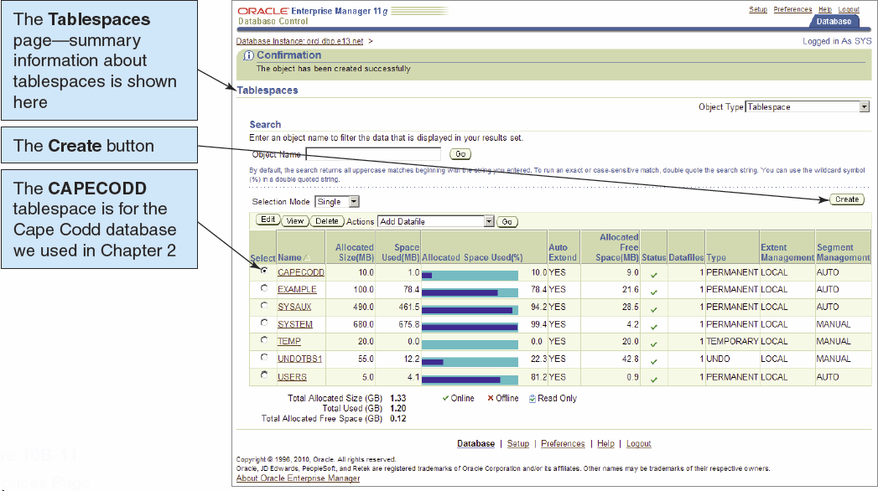
Tablespaces III

Slide 18
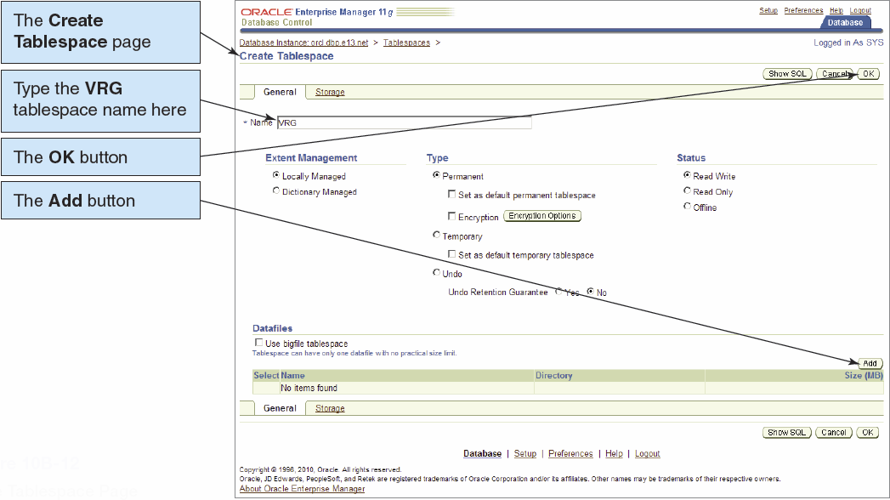
Tablespaces IV

Slide 19
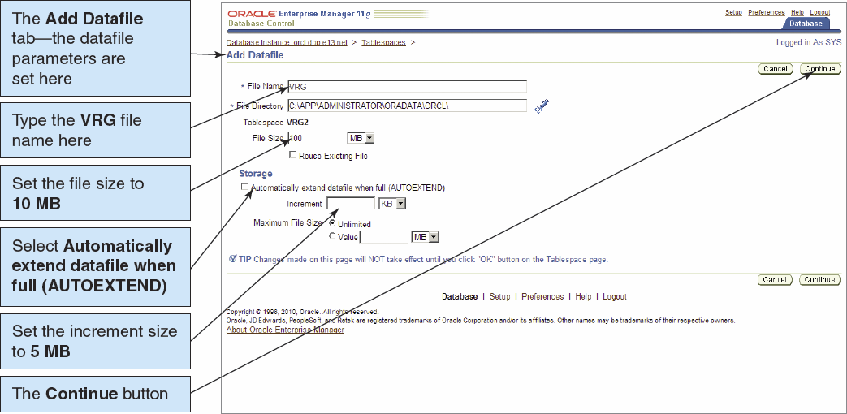
Tablespaces V

Slide 20
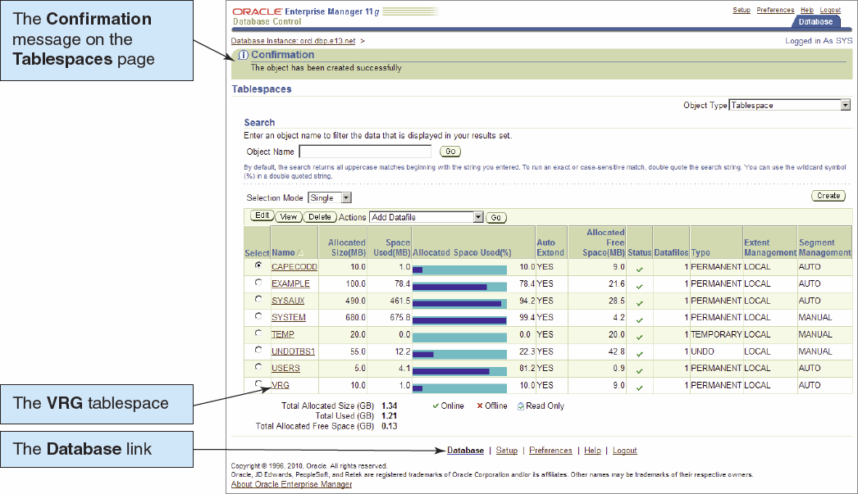
Tablespaces VI

Slide 21
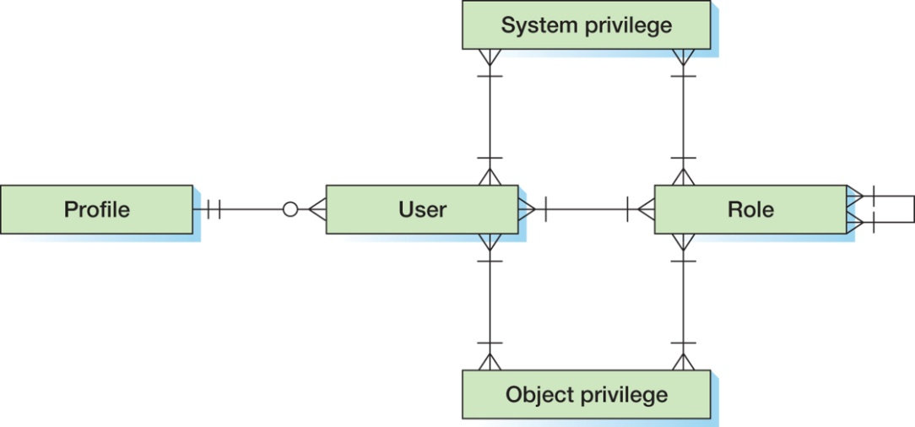
Oracle Security
Oracle security components:
A USER is a user account.
A PROFILE is a set of system resource maximums that are assigned to an account.
A SYSTEM PRIVILEGE is the right to perform a task.
An OBJECT PRIVILEGE is the right to work with that object.
A ROLE consists of groups of PRIVILEGEs and other ROLEs.

Slide 22
USER System Privileges
Each USER can be allocated many SYSTEM PRIVILEGEs, OBJECT PRIVILEGEs and ROLEs.
A USER account has all the PRIVILEGEs:
That have been assigned directly
Of all of its ROLEs
Of all of its ROLEs that are inherited through ROLE connections
A ROLE can have many SYSTEM PRIVILEGEs and OBJECT PRIVILEGEs, and it may also have a relationship to other ROLEs.
ROLEs simplify the administration of the database:
A set of privileges can be assigned to or removed from a ROLE just once.

Slide 23
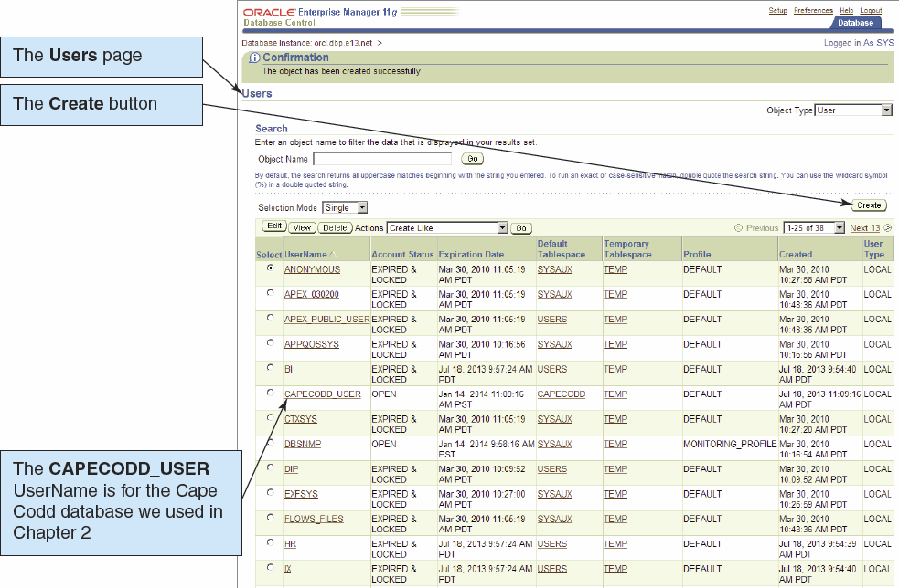
Users, Roles, and Privileges I

Slide 24
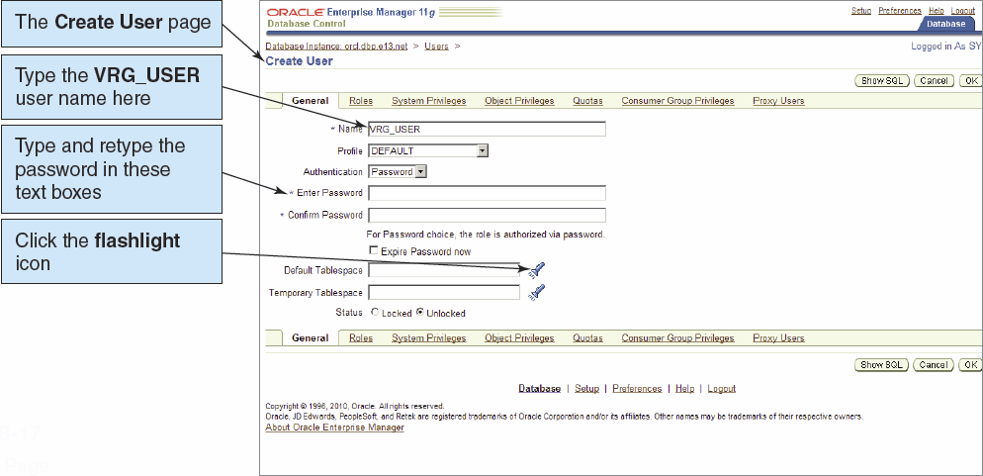
Users, Roles, and Privileges II

Slide 25
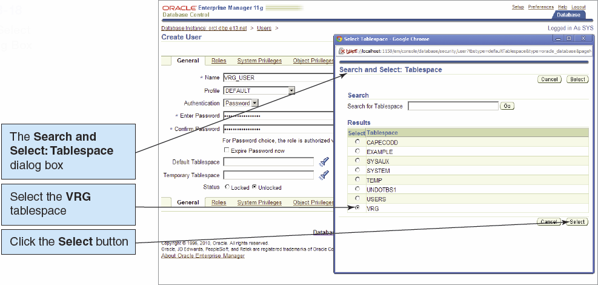
Users, Roles, and Privileges III

Slide 26
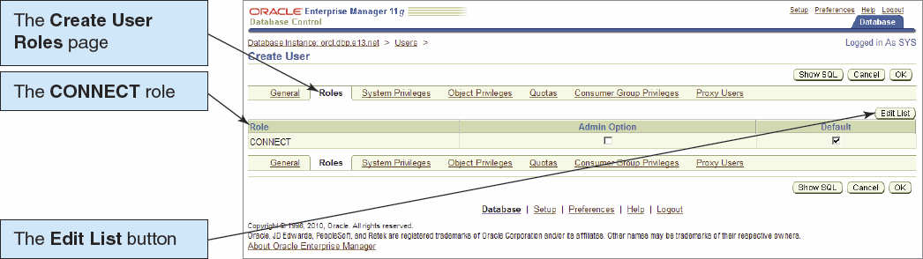
Users, Roles, and Privileges IV

Slide 27
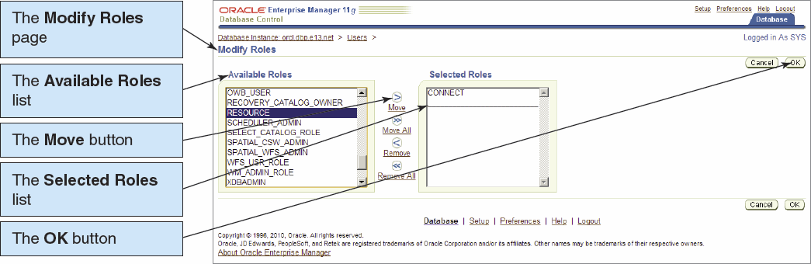
Users, Roles, and Privileges V

Slide 28
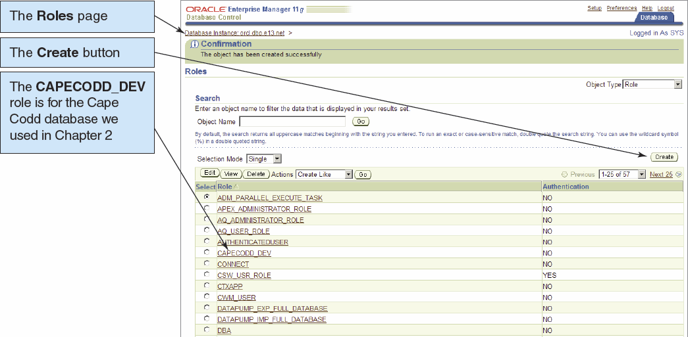
Users, Roles, and Privileges VI

Slide 29
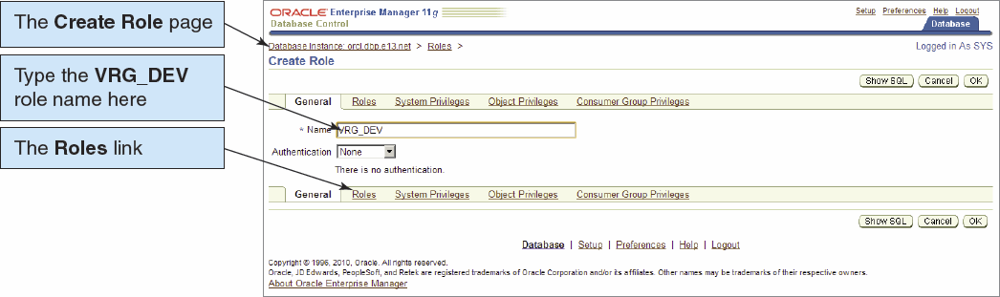
Users, Roles, and Privileges VII

Slide 30
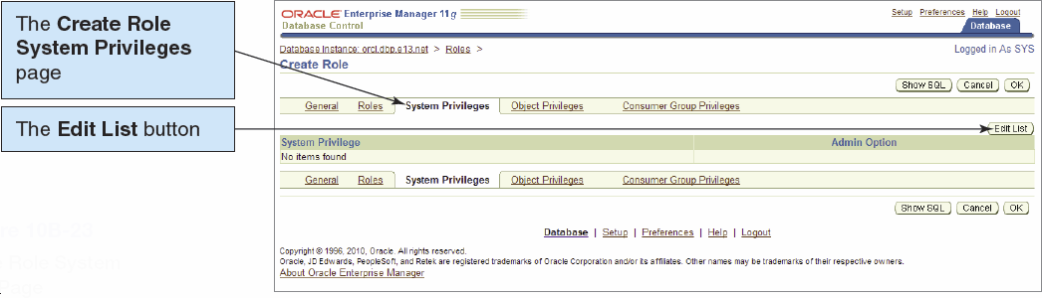
Users, Roles, and Privileges VIII

Slide 31
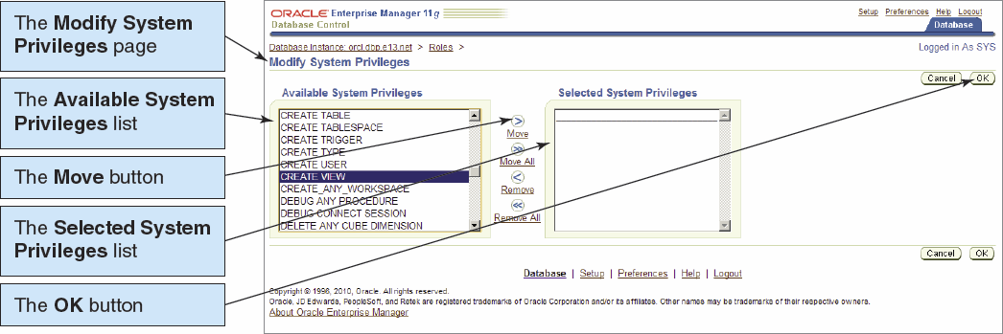
Users, Roles, and Privileges IX

Slide 32
Oracle Application Development Utilities
Oracle SQL*Plus or the Oracle SQL Developer Console may be used for application development.
SQL*Plus is a text editor.
SQL Developer is a GUI utility.

Slide 33
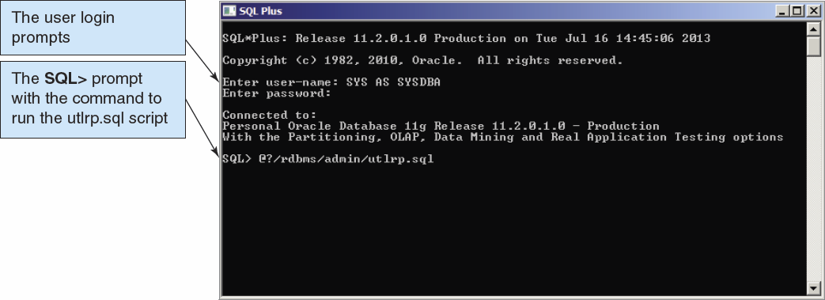
SQL*Plus

Slide 34
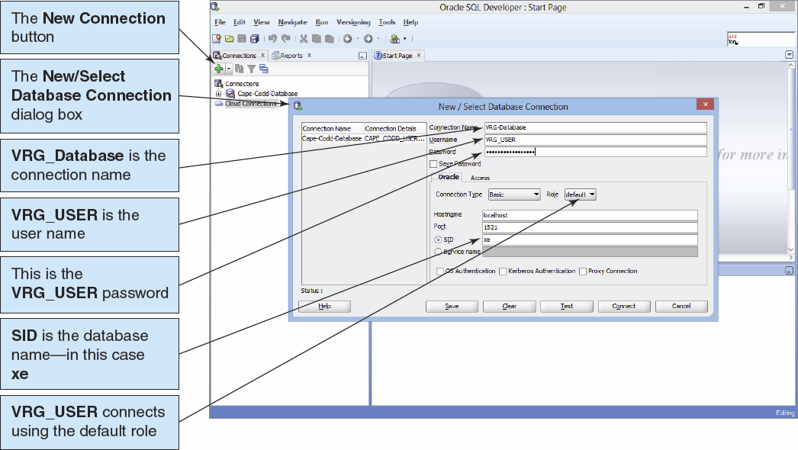
SQL Developer I

Slide 35
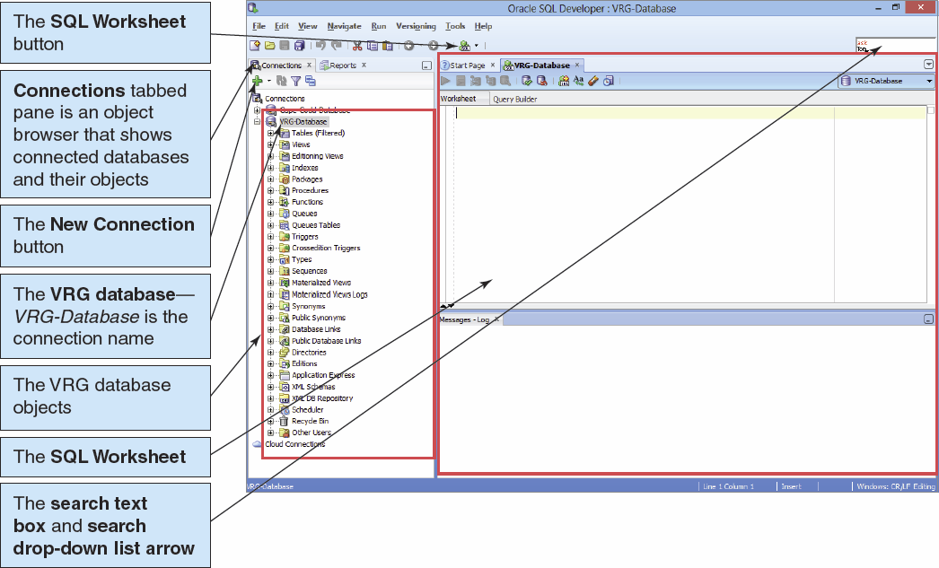
SQL Developer II

Slide 36
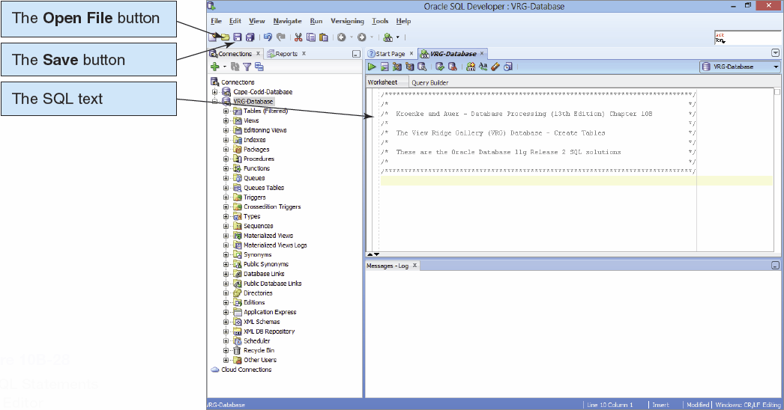
SQL Scripts I

Slide 37
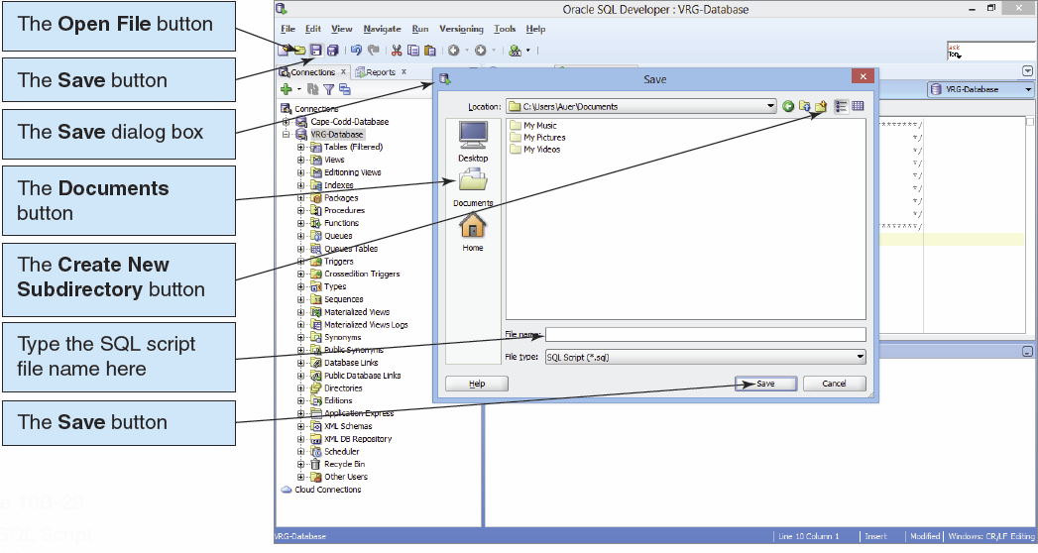
SQL Scripts II

Slide 38
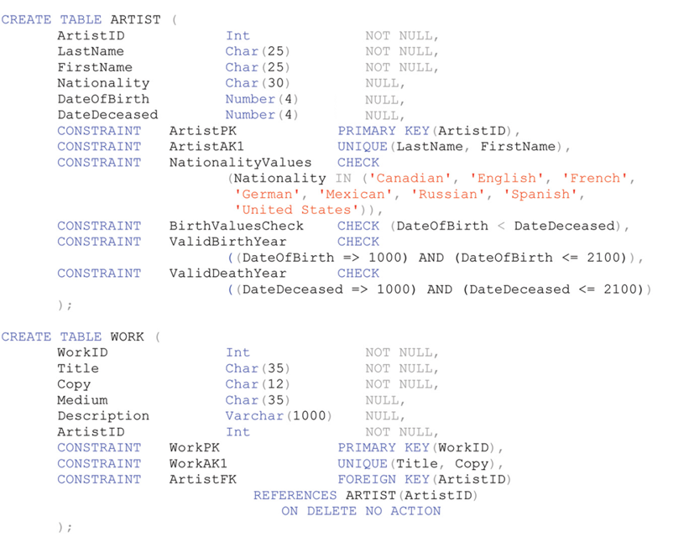
Oracle CREATE TABLE Statements for the View Ridge Schema I

Slide 39
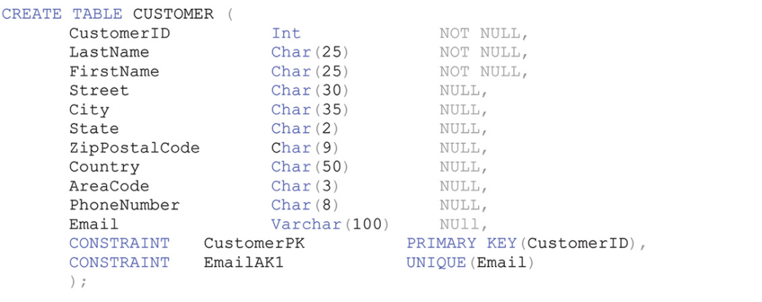
Oracle CREATE TABLE Statements for the View Ridge Schema II

Slide 40
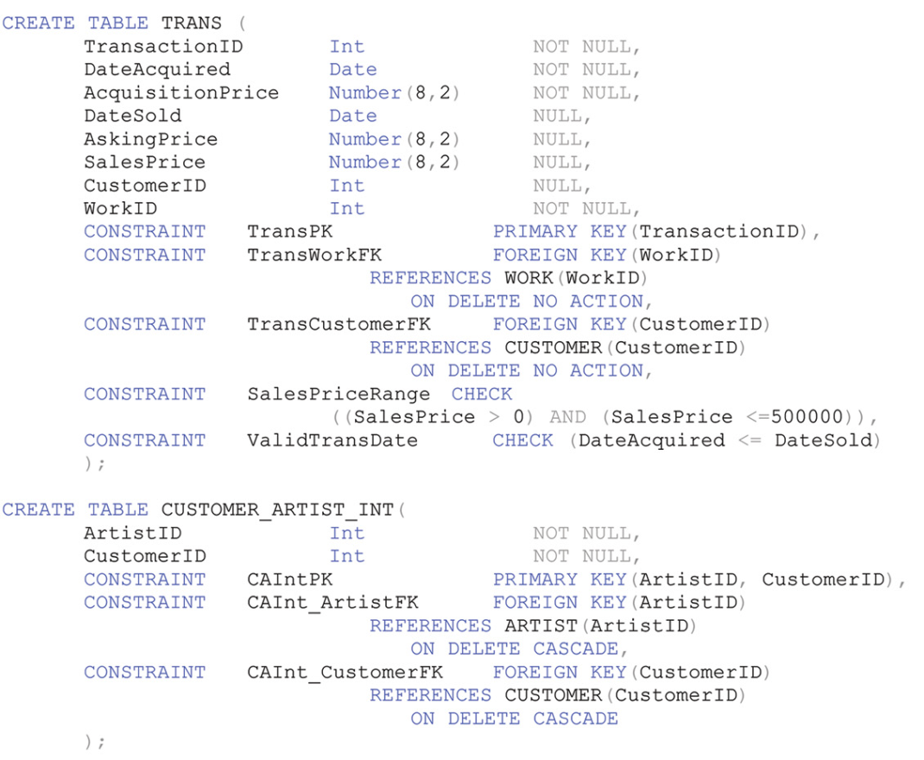
Oracle CREATE TABLE Statements for the View Ridge Schema III

Slide 41
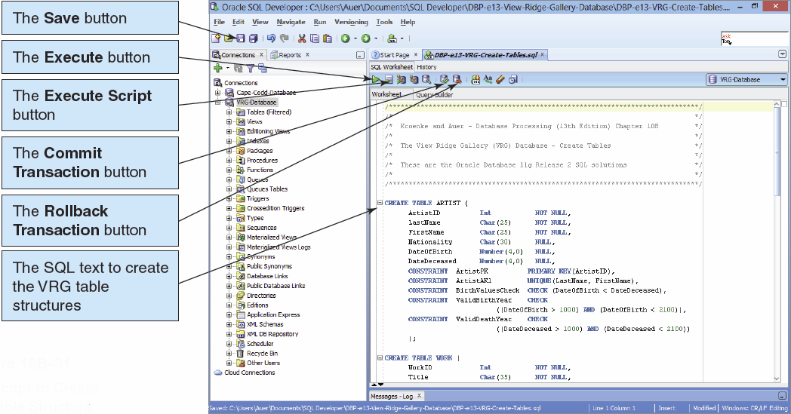
Oracle CREATE TABLE Statements for the View Ridge Schema IV

Slide 42
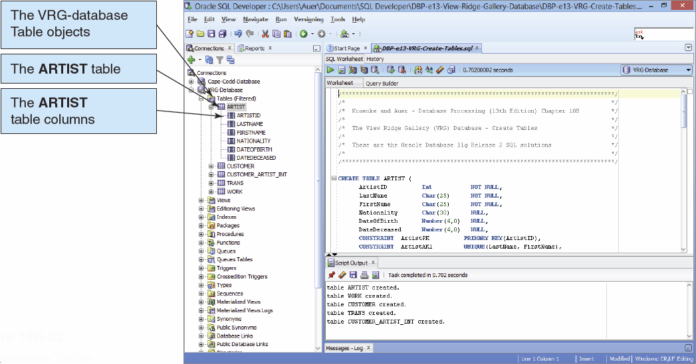
Oracle CREATE TABLE Statements for the View Ridge Schema V

Slide 43
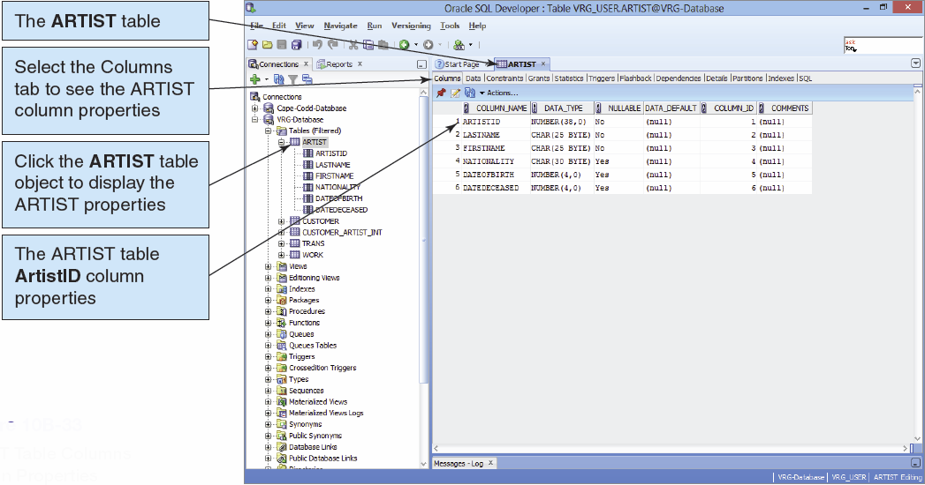
Inspecting Table Properties I

Slide 44
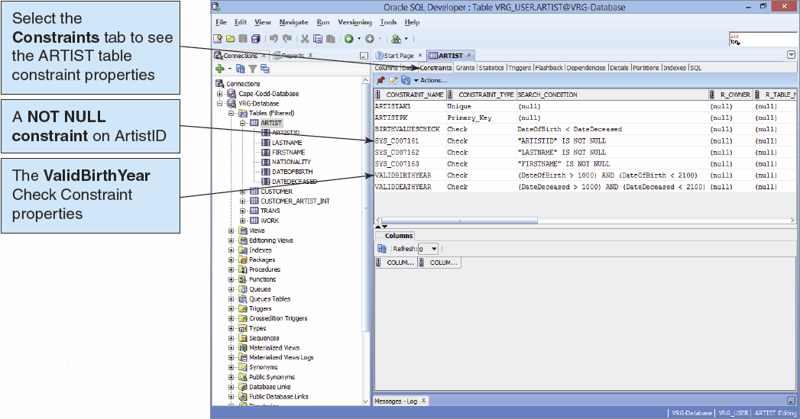
Inspecting Table Properties II

Slide 45
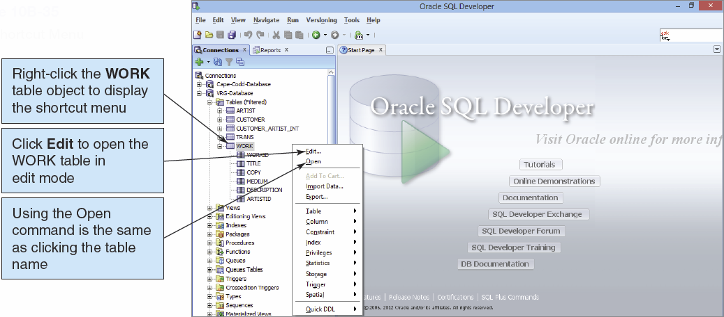
Inspecting Table Properties III

Slide 46
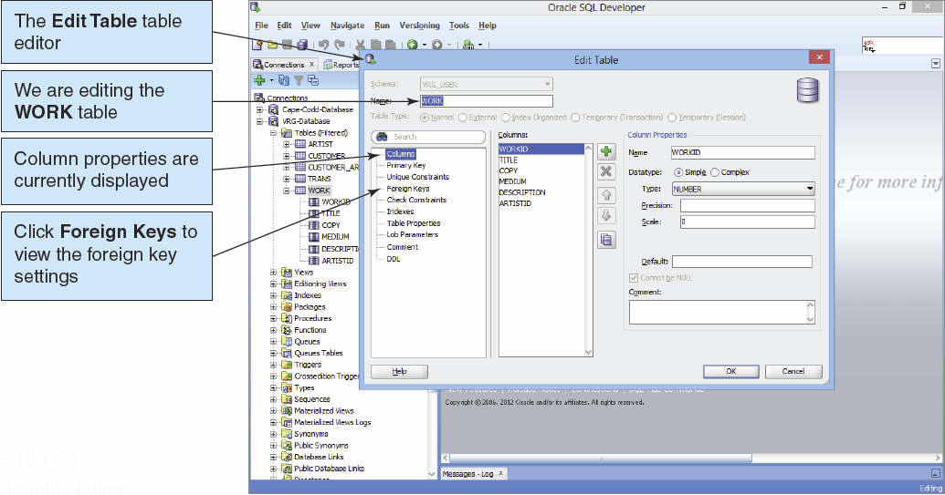
Inspecting Table Properties IV

Slide 47
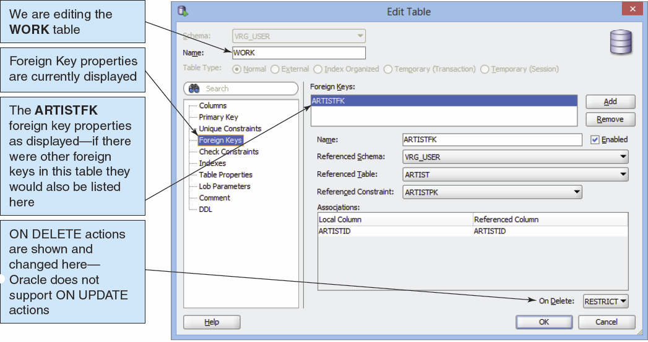
Inspecting Table Properties V

Slide 48
Creating Indexes I
Indexes are created to:
Enforce uniqueness on columns
Facilitate sorting
Enable fast retrieval by column values
Good candidates for indexes are columns that are frequently used with equal conditions in WHERE clause or in a join.
Examples:
CREATE INDEX CustNameIdx ON CUSTOMER(Name);
CREATE UNIQUE INDEX WorkUniqueIndex ON WORK(Title, Copy, ArtistID);

Slide 49
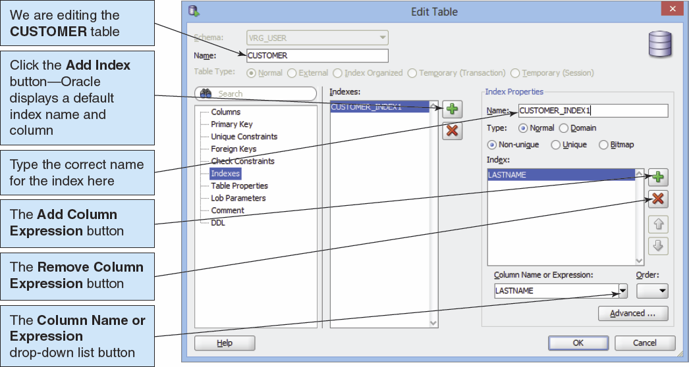
Creating Indexes II

Slide 50
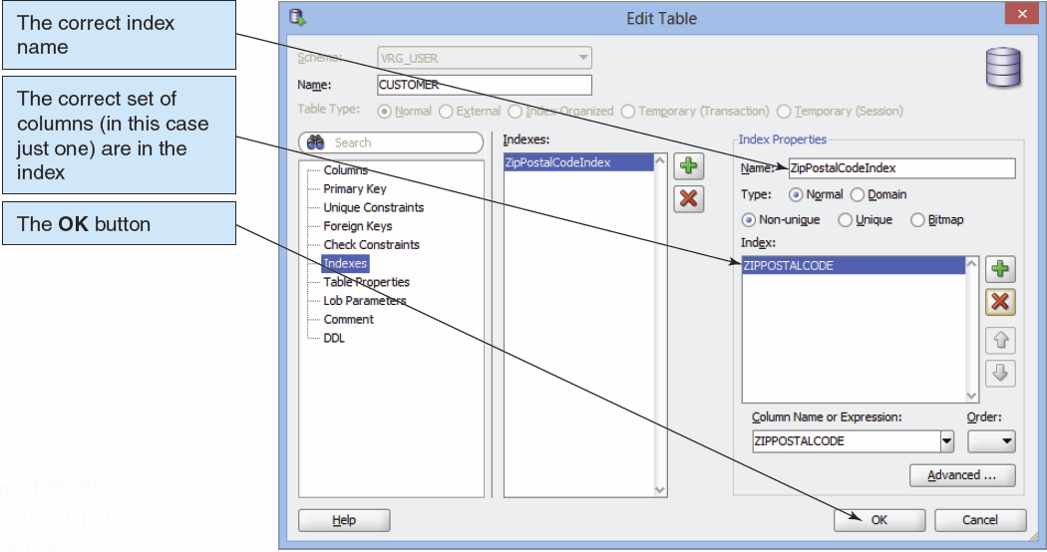
Creating Indexes III

Slide 51
Oracle Sequences
A sequence is an object that generates a sequential series of unique numbers.
Create Sequence CustID Increment by 1 start with 1000;
It is the best way to work with surrogate keys in Oracle.
Two sequence methods:
NextVal provides the next value in a sequence.
CurrVal provides the current value in a sequence.
Using sequences does not guarantee valid surrogate key values because it is possible to have missing, duplicate, or wrong sequence values in the table.

Slide 52
Using Sequences
Creating a sequence:
CREATE SEQUENCE seqCID INCREMENT BY 1 START WITH 1000;
Entering data using a sequence:
INSERT INTO CUSTOMER
(CustomerID, Name, AreaCode, PhoneNumber)
VALUES(
seqCID.NextVal, 'Mary Jones', '350', '555–1234');
Retrieving the row just created:
SELECT *
FROM CUSTOMER
WHERE CustomerID = seqCID.CurrVal;

Slide 53
The TO_DATE Function
Oracle requires dates in a particular format.
TO_DATE function may be used to identify the format:
TO_DATE('11/12/2013', 'MM/DD/YYYY')
11/12/2011 is the date value.
MM/DD/YYYY is the pattern to be used when interpreting the date.
The TO_DATE function can be used with the INSERT and UPDATE statements to enter data:
INSERT INTO T1 VALUES(
100, TO_DATE ('01/05/2013', 'DD/MM/YYYY'));

Slide 54
Creating Views I
The CREATE VIEW statement can be used to create views in Oracle.
Unlike SQL-92, Oracle allows the ORDER BY clause in view definitions.
Oracle supports the JOIN…ON syntax.
Example:
CREATE VIEW CustomerInterests AS
SELECT C.LastName AS CustomerLastName,
C.FirstName AS CustomerFirstName,
A.LastName AS ArtistName
FROM CUSTOMER C JOIN CUSTOMER_ARTIST_INT CAI
ON C.CustomerID = CAI.CustomerID JOIN ARTIST A
ON CAI.ArtistID = A.ArtistID;

Slide 55
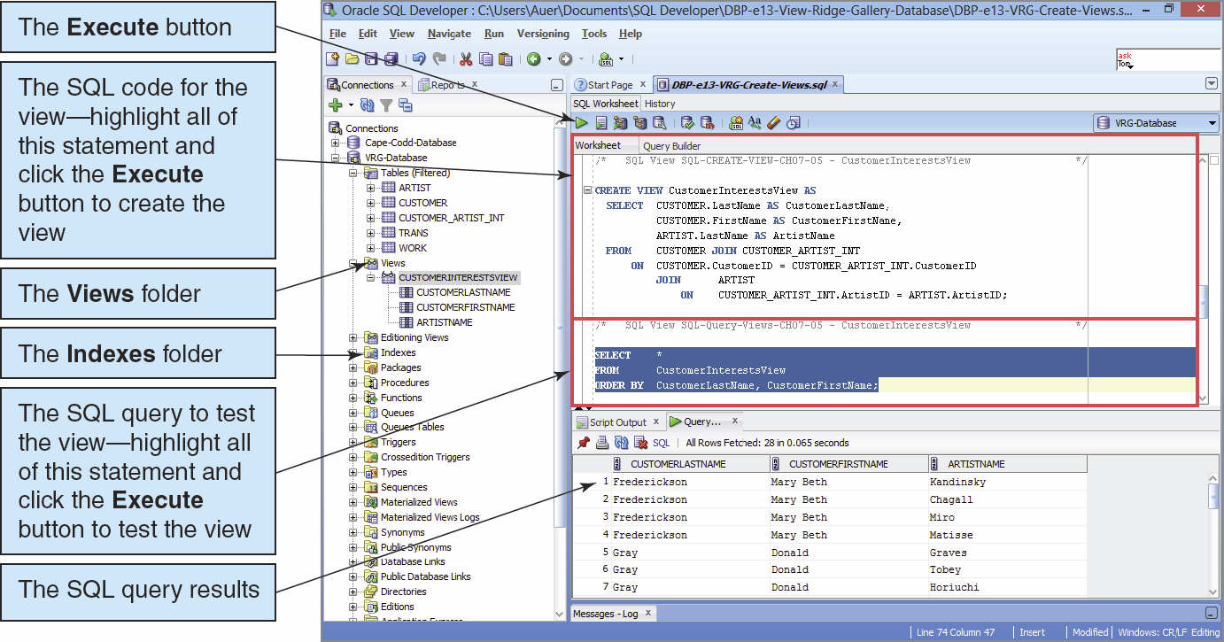
Creating Views II

Slide 56
Application Logic I
Oracle Database implements the SQL/Persistent Stored Modules (SQL/PSM) standard in the Oracle Database Procedural Language/SQL (PL/SQL).
Oracle Database also supports the use of the Java programming language for writing Oracle Database functions, stored procedures and triggers.

Slide 57
Application Logic II
Oracle database applications can be processed using:
Programming languages to invoke DBMS commands
The SQL*Plus Command Line utility to invoke database commands stored in .sql files
The SQL Developer to invoke database commands stored in .sql files
Stored procedures
Triggers

Slide 58
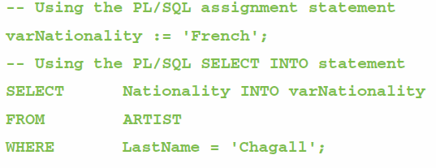
Application Logic: Parameters and Variables
A parameter is a value passed to a stored procedure.
A variable is a value used within the stored procedure.

Slide 59
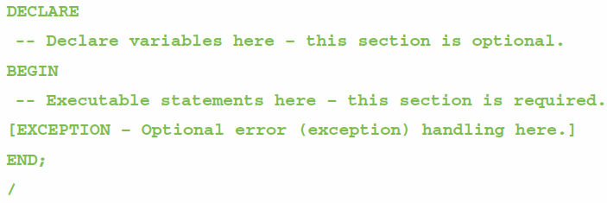
Application Logic: Oracle Block Structure
Oracle blocks must end with a single slash (/) as a signal to compile and execute the code to create the procedure or trigger:
This is a slash (/)

Slide 60
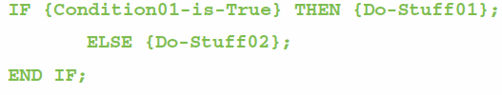
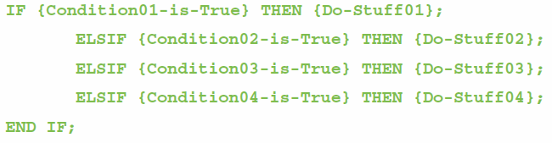
Application Logic: Oracle Control of Flow Statements I
IF…THEN…ELSE…END IF
IF…ELSIF…END IF

Slide 61
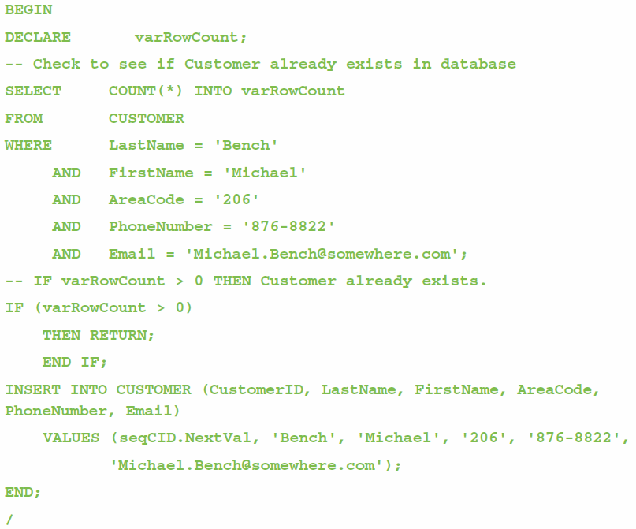
Application Logic: Oracle Control of Flow Statements II
BEGIN…END
RETURN

Slide 62
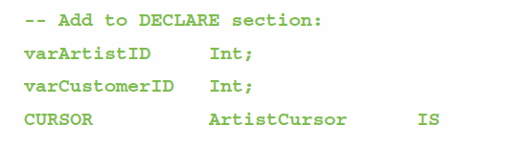
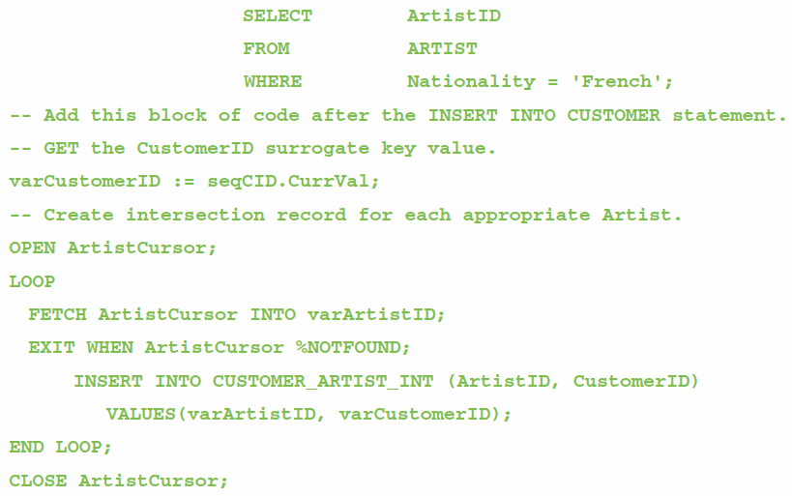
Application Logic: Oracle Cursor Statements
DECLARE
OPEN
FETCH
LOOP
FOR
WHILE
EXIT WHEN
CLOSE

Slide 63
Application Logic: Oracle Output Statements
Oracle uses the
DBMS_OUTPUT.PUT_LINE ({text here})
statement for output.
To use this statement, you must first execute:
SET SERVEROUT ON

Slide 64
SQL/Persistent Stored Modules (SSL/PSM)
SQL/Persistent Stored Modules (SQL/PSM) is an ANSI/ISO standard for embedding procedural programming functionality into SQL.
Each DBMS product implements SQL/PSM in a different way, with some closer to the standard than others.
Microsoft SQL Server 2012 calls its version Transact-SQL (T-SQL).
Oracle Database 11g Release 2 calls its variant Procedural Language/SQL (PL/SQL).
MySQL 5.6 implements SQL/PSM, but has no special name for its variant of SQL.

Slide 65
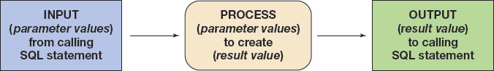
User-Defined Functions I
A user-defined function (stored function) is a stored set of SQL statements that:
is called by name from another SQL statement
may have input parameters passed to it by the calling SQL statement, and
returns an output value to the SQL statement that called the function.

Slide 66
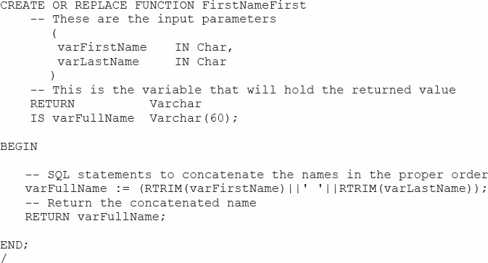
User-Defined Functions II The FirstNameFirst Function

Slide 67
User-Defined Functions III The FirstNameFirst Function
Using the FirstNameFirst function:
SELECT dbo.FristNameFirst(FirstName, LastName) AS CustomerName,
Sreet, City, State, ZipPostalCode
FROM CUSTOMER
ORDER BY CustomerName;

Slide 68
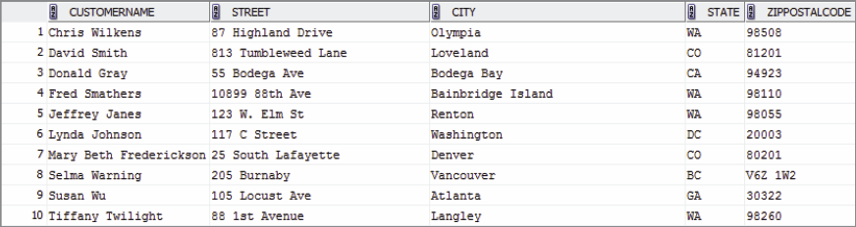
User-Defined Functions IV The FirstNameFirst Function
FirstNameFirst function results:

Slide 69
Stored Procedures I
A stored procedure is a PL/SQL or Java program stored within the database.
Stored procedures are programs that can:
Have parameters.
Invoke other procedures and functions.
Return values.
Raise exceptions.
A stored procedure must be compiled and stored in the database.

Slide 70
Stored Procedures I
The CALL command is used to invoke a stored procedure:
SET SERVEROUTPUT ON
CALL InsertCustomerAndInterests
('Bench', 'Michael','206', ‘876-8822',
'Michael.Bench@somewhere.com', 'French');

Slide 71
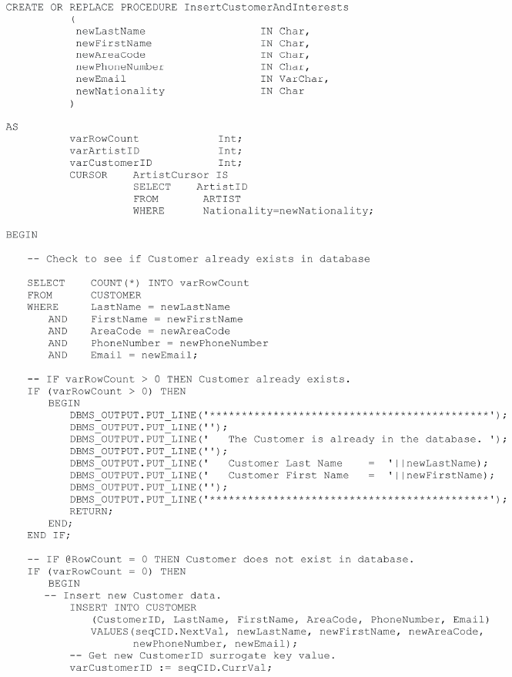

Slide 72
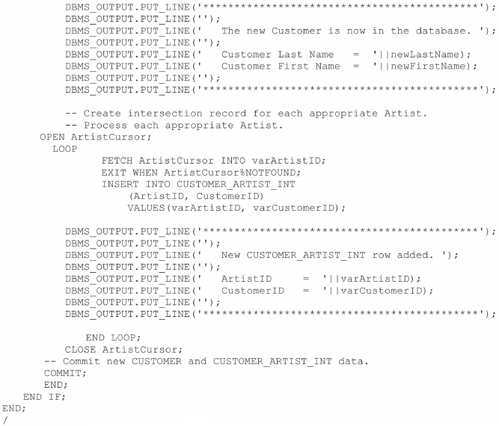

Slide 73

Running Stored Procedures

Slide 74
Triggers
An Oracle trigger is a PL/SQL or Java procedure that is invoked when a specified database activity occurs.
Triggers can be used to:
Set default values.
Enforce a Data Constraint.
Update a view.
Enforce referential integrity action.
Handle exceptions.

Slide 75
Triggers
Trigger types:
A command trigger will be fired once per SQL command.
A row trigger will be fired once for every row involved in the processing of an SQL command.
There are three types of row triggers: BEFORE, AFTER, and INSTEAD OF.
BEFORE and AFTER triggers are placed on tables while INSTEAD OF triggers are placed on views.
Each trigger can be fired on INSERT, UPDATE, or DELETE commands.

Slide 76


Slide 77

Running Triggers

Slide 78

Triggers Comparison

Slide 79
Concurrency Control
Oracle processes database changes by maintaining a System Change Number (SCN).
SCN is a database-wide value that is incremented by Oracle when database changes are made.
With SCN, SQL statements always read a consistent set of values; those that were committed at or before the time the statement was started.
Oracle only reads committed changes; it will never read dirty data.

Slide 80

Oracle Transaction Isolation

Slide 81
Oracle Recovery Facilities
Three file types for Oracle recovery:
Datafiles contain user and system data.
ReDo log files contain logs of database changes.
Online ReDo files are maintained on disk and contain the rollback segments from recent database changes.
Offline or Archive ReDo files are backups of the Online ReDo files.
Control files describe the name, contents, and locations of various files used by Oracle.

Slide 82
Oracle Recovery Facilities
Oracle can operate in either ARCHIVELOG or NOARCHIVELOG mode:
If running in ARCHIVELOG mode, Oracle logs all changes to the database.
When the Online ReDo files fill up, they are copied to the Archive ReDo files.
The Oracle Recovery Manager (RMAN) is a utility program used to create backups and to perform recovery.

Slide 83
Types of Failure
Oracle recovery techniques depend on the type of failure:
An application failure due to application logic errors.
An instance failure occurs when Oracle itself fails due to an operating system or computer hardware failure.
Oracle can recover from application and instance failure without using the archived log file.
A media failure occurs when Oracle is unable to write to a physical file because of a disk failure or corrupted files.
The database is restored from a backup.

Slide 84
Oracle Backup Facilities
Two kinds of backups:
A consistent backup: database activity must be stopped and all uncommitted changes have been removed from the datafiles
Cannot be done if the database supports 24/7 operations.
An inconsistent backup: backup is made while Oracle is processing the database
An inconsistent backup can be made consistent by processing an archive log file.

Slide 85
David Kroenke and David Auer Database Processing Fundamentals, Design, and Implementation (13th Edition)
End of Presentation:
Chapter Ten B

Slide 86

All rights reserved. No part of this publication may be reproduced, stored in a retrieval system, or transmitted, in any form or by any means, electronic, mechanical, photocopying, recording, or otherwise, without the prior written permission of the publisher. Printed in the United States of America.

